Slide 1

REMOTEBASE
HACKFEST ‘21
Team 373 – Tech Clan

Slide 2
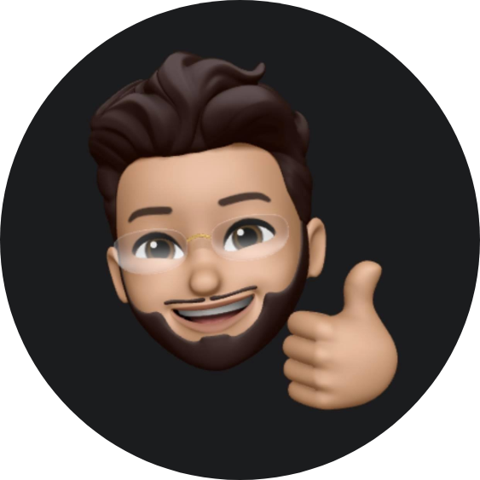
Team Members
Syed Ali Raza
Full Stack Developer
Adnan Ali
Full Stack Developer
Anas
Full Stack Developer
Imtiaz
Full Stack Developer
Zohair
Full Stack Developer

Slide 3
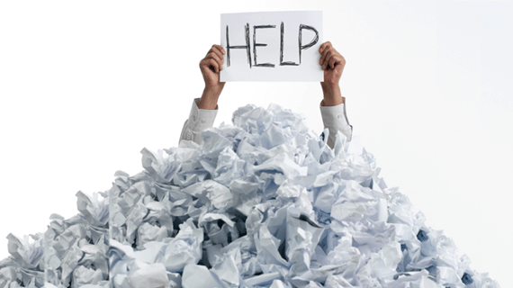
remoteBase
Challenge
Track
Problem Statement
There are currently challenges when working remotely.
Anyone can get overwhelmed while working this way.
Software Setup
Different Sites
Too much context switching
Productivity Loss
Cross Time Zone Team collaboration
Content Sharing
Lack of Social Interaction

Slide 4
Solution
Single window of operation & interaction
No matter the application, we got you covered

Slide 5


Team Strategy
Ease of use using Integrations
Improve engagement using gamification

Slide 6












Design and Architecture

Slide 7

Frontend/Backend

Slide 8
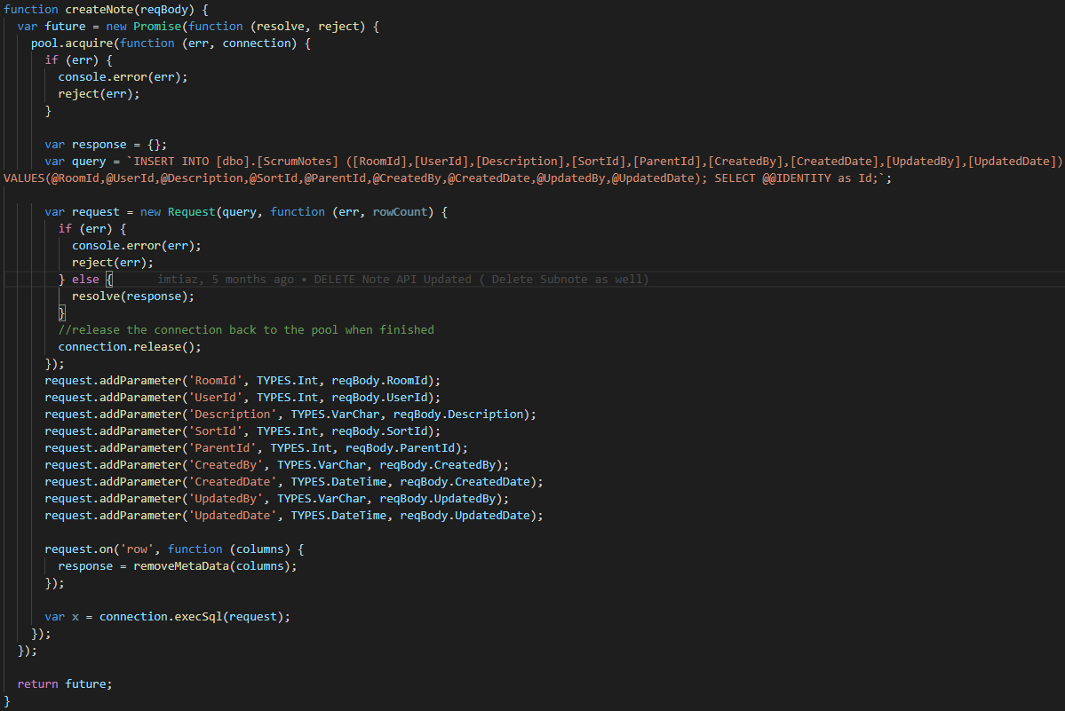
Code Demo

Slide 9
Thank you
Any Questions?

